Slide 1
ESGG main crops seeds group - statistical overview
Helsinki – Finland – June 5th

Slide 2
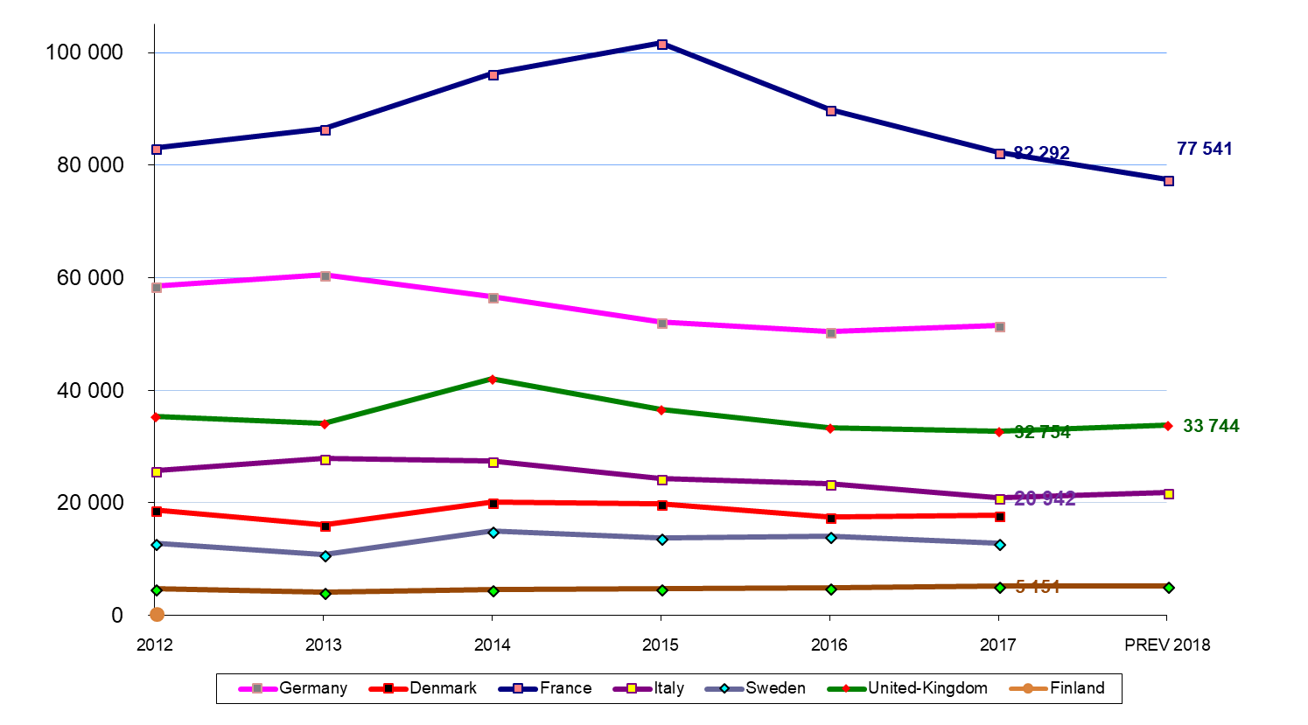
Winter wheat / blé d’hiver Ha

Slide 3
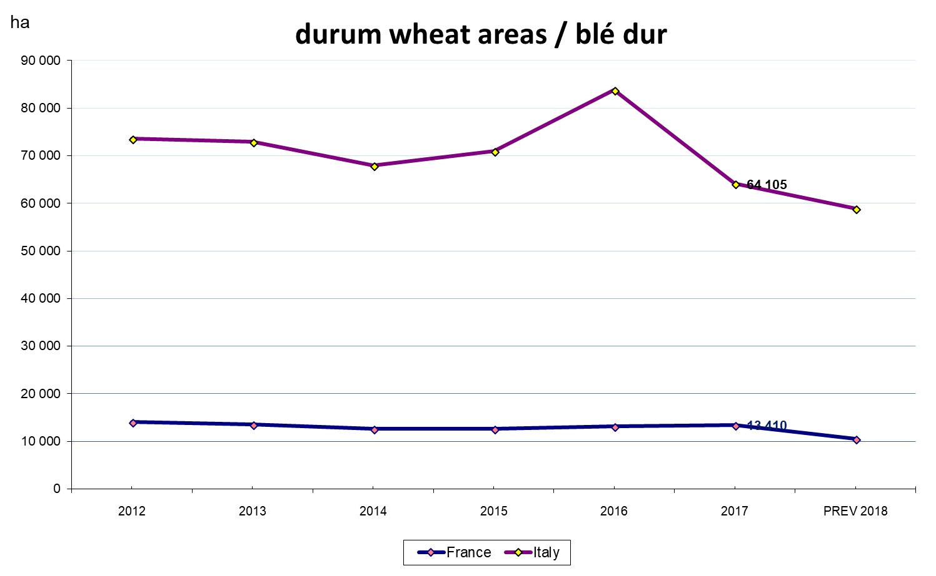
Durum wheat / blé dur Ha

Slide 4
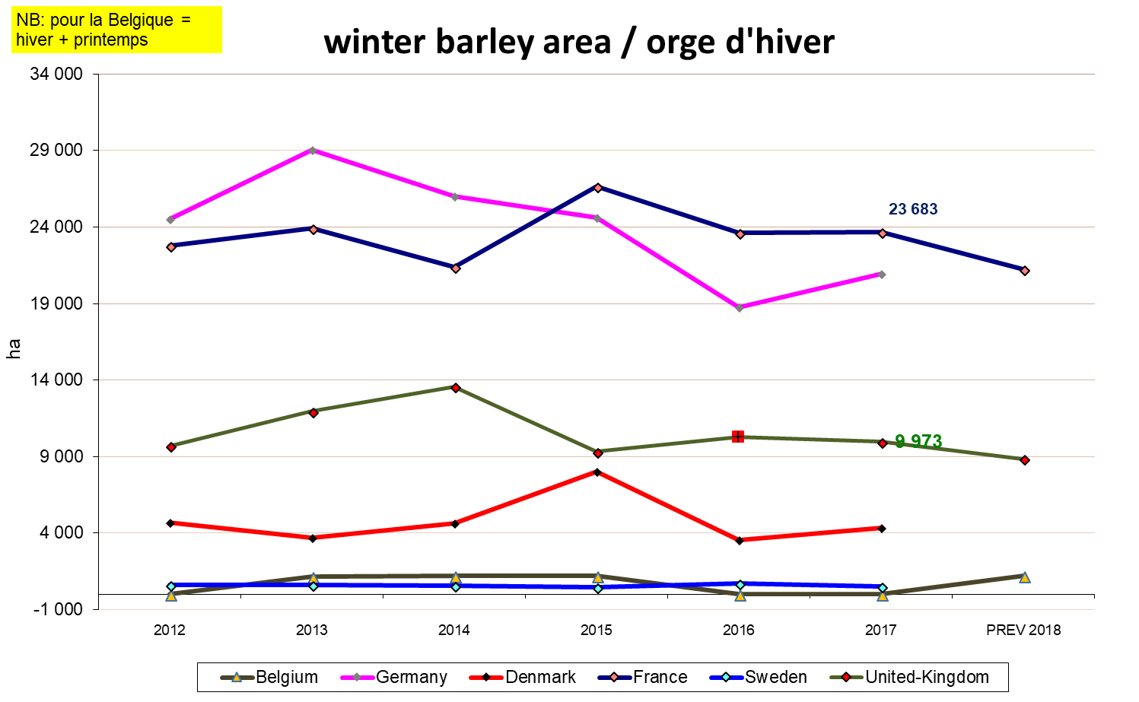
Winter barley / orge d’hiver Ha
NB : for Belgium, it’s winter and summer barley area

Slide 5
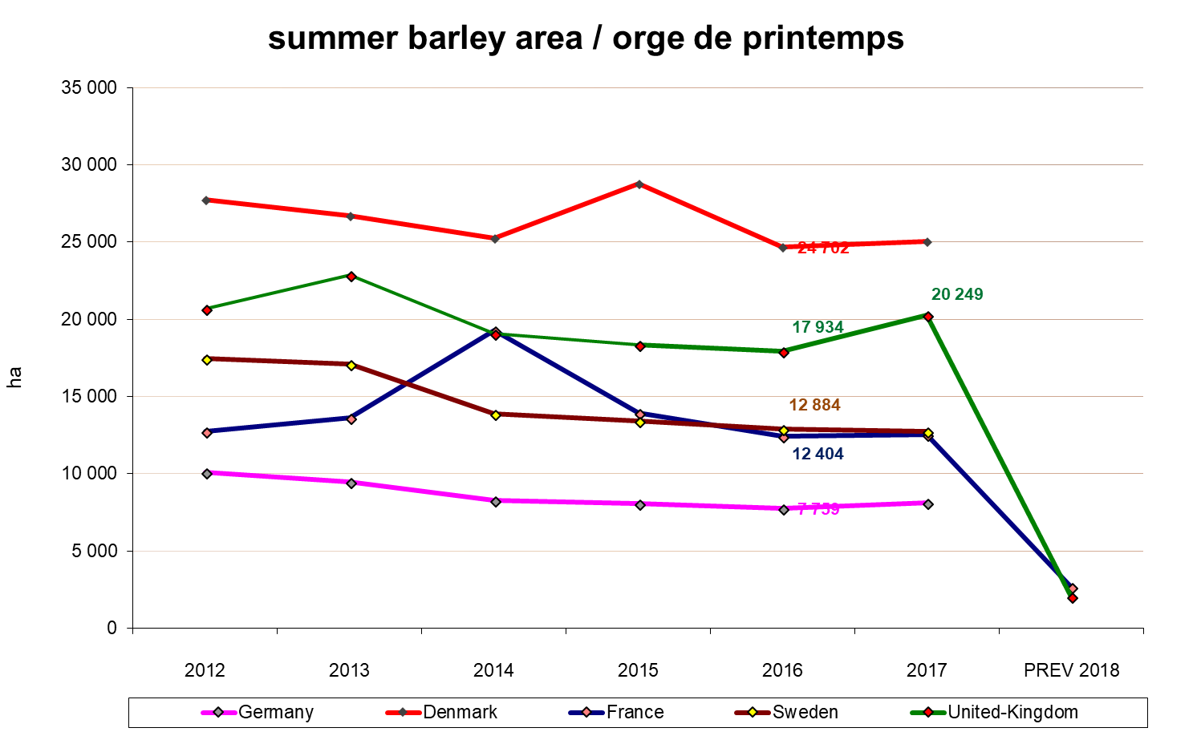
Summer barley / Orge de printemps Ha

Slide 6
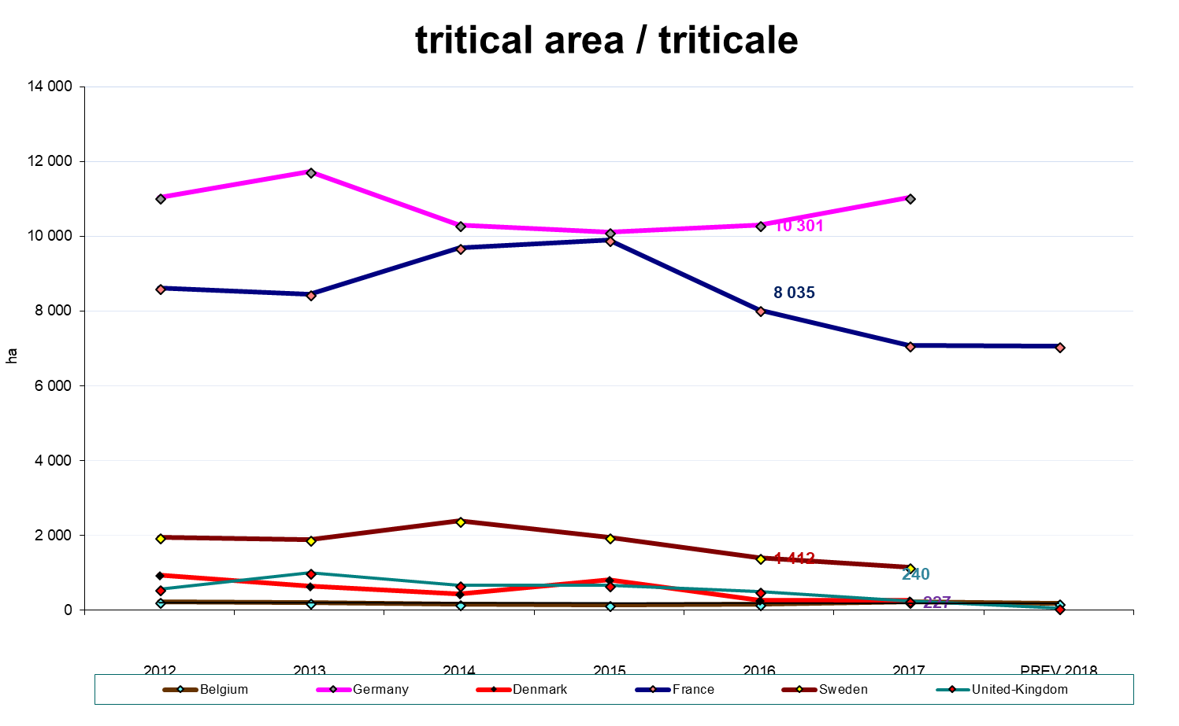
Tritical / Triticale Ha

Slide 7
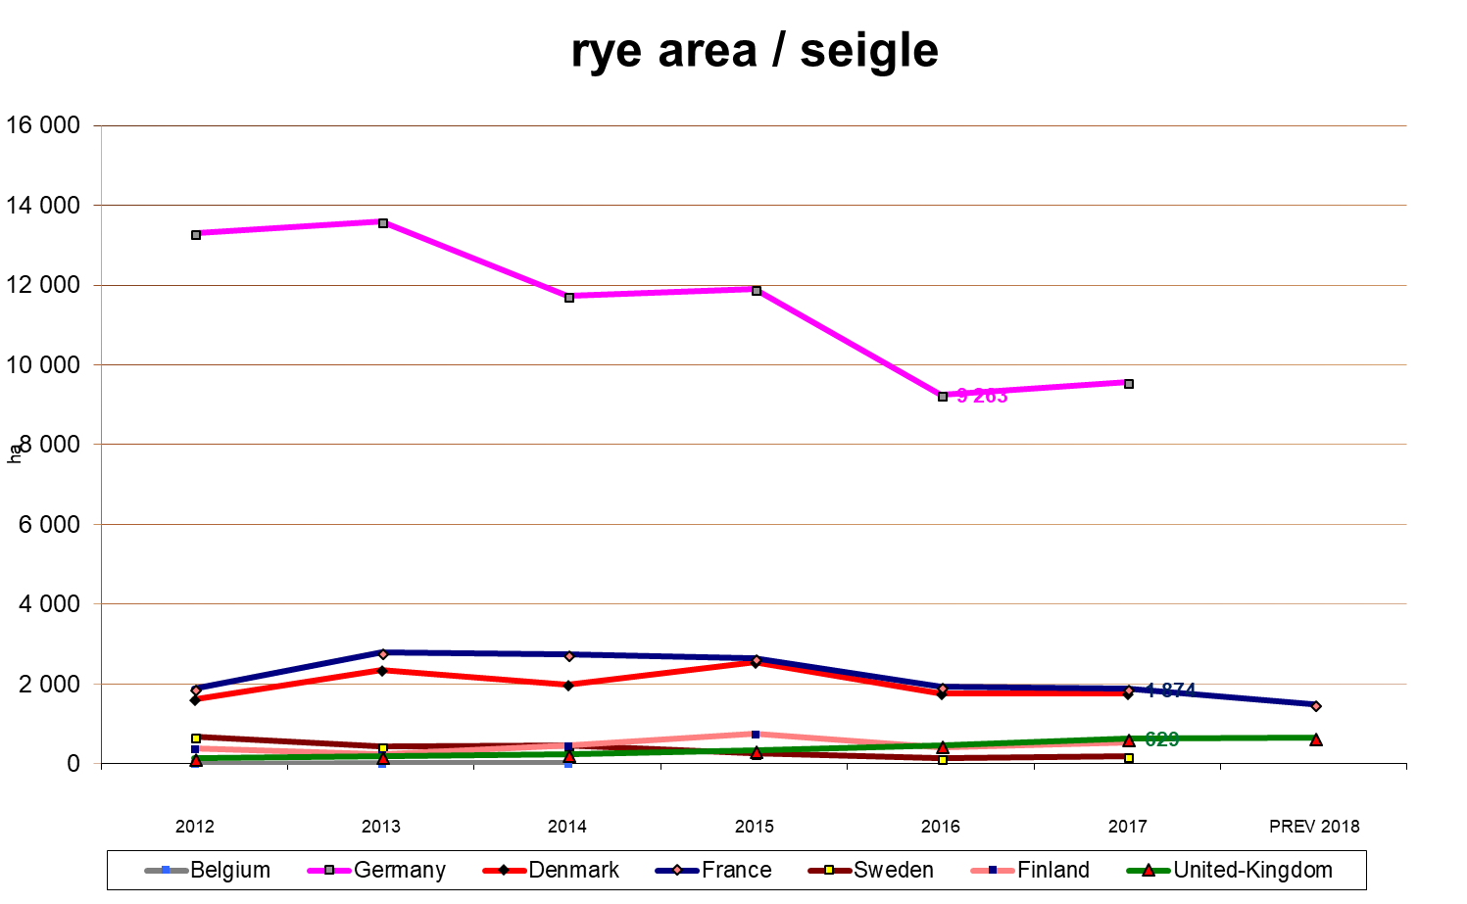
Rye / seigle Ha

Slide 8
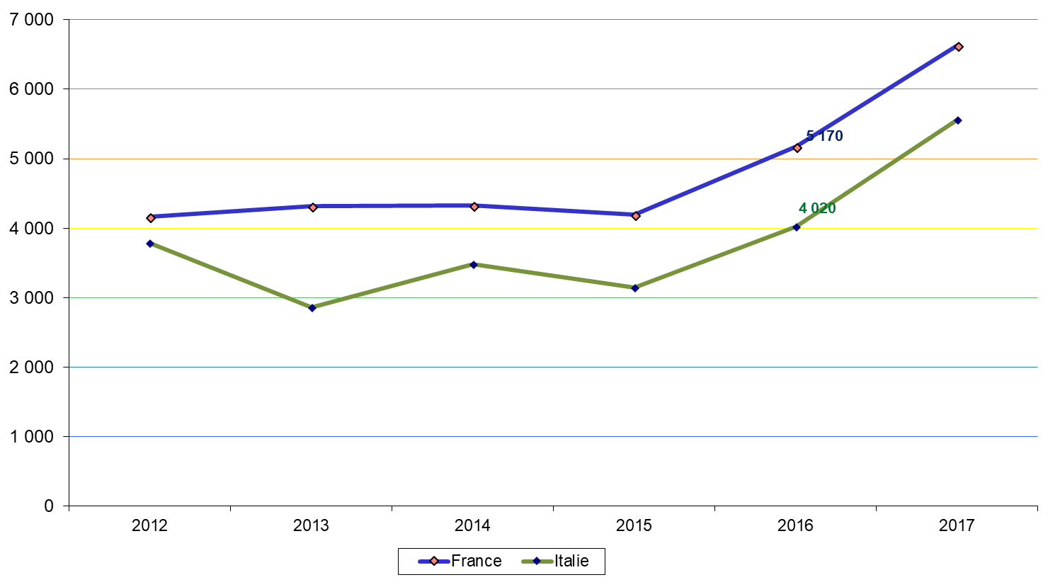
Sugar beet / betterave Ha

Slide 9
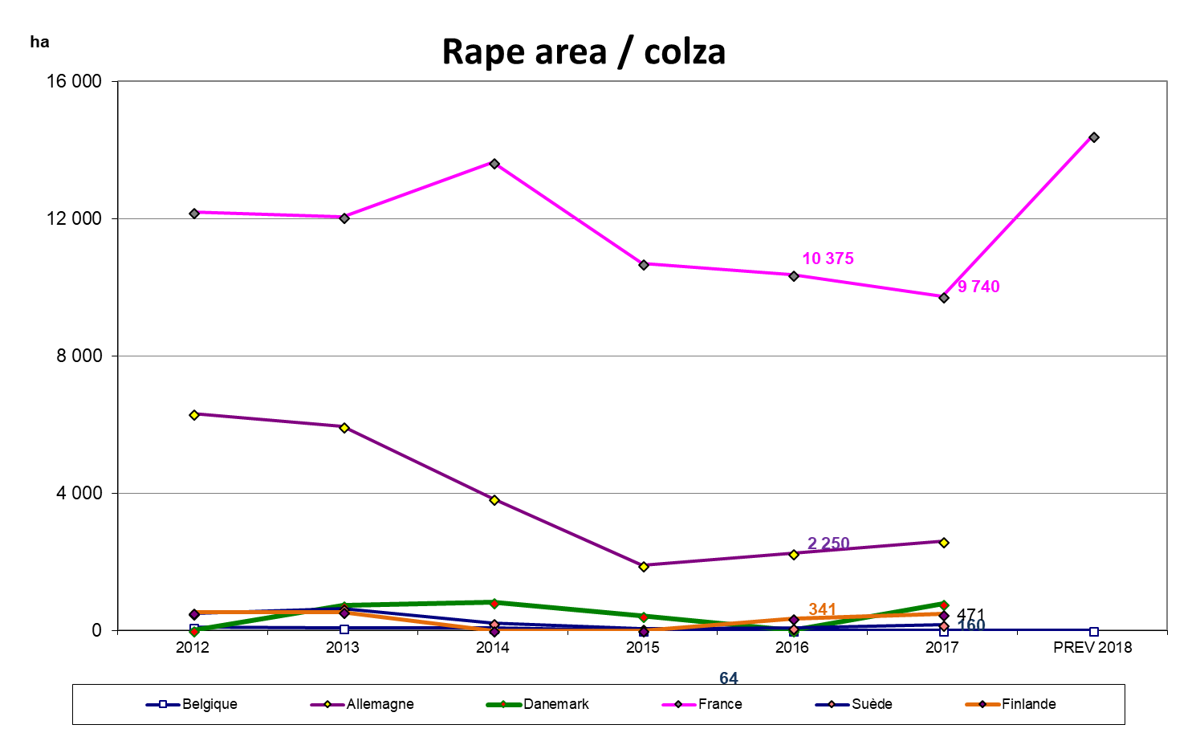
Rape / Colza Ha

