Slide 1
ESGG - Brexit Update
Tori Morgan
NFU Combinable Crops Adviser
Tori.morgan@nfu.org.uk
@torimorgan91

Slide 2
BREXIT and AGRICULTURE The Challenge Ahead
PROCESS
POLICY
POLITICS

Slide 3
THE PROCESS
No negotiation without notification: EU (Notification of Withdrawal) Bill now enacted.
Article 50 triggered 29 March 2017 – EC must now adopts negotiating “guidelines”. EU Summit 29 April 2017
Two year process – can be extended by unanimous agreement – to negotiate “withdrawal agreement.”
Question over agreement on “future relationship”
French elections April/May 2017, German elections Autumn 2017.
UK Parliamentary (and EU Parl) approval required
Great Repeal Bill & other legislation

Slide 4
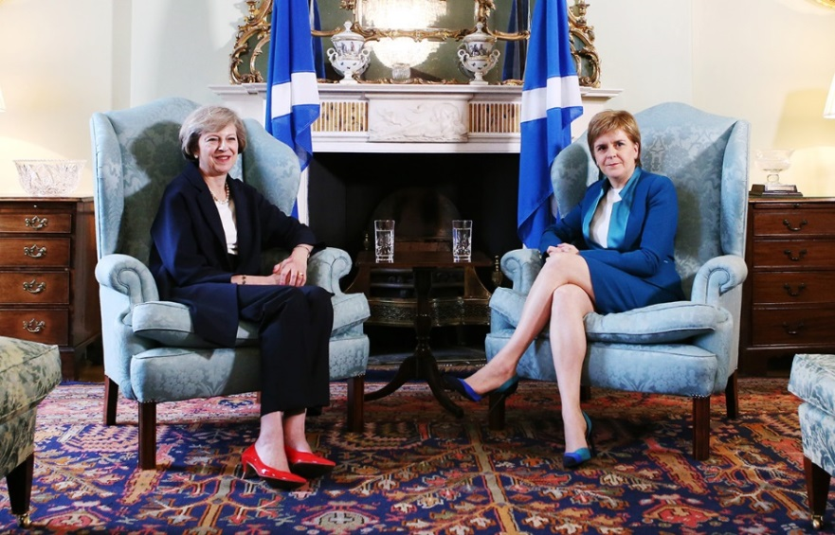
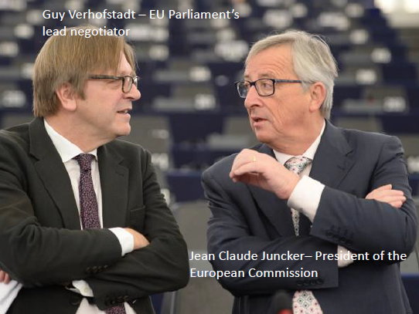
POLITICS!
Notes:
1st picture – Teresa May and Nicola Sturgeon
2nd picture – Guy Verhofstadt, EU Parliament lead negotiator and Jean Claude Junker, President of European Commission
3rd pictue – 27 member states

Slide 5
NFU’s Policy Priorities
As we negotiate our exit from the EU, and forge a new trading relationship with the rest of the world, it is critical that UK farming is supported in being productive, efficient and sustainable.
FOR OUR WELLBEING: A safe and affordable domestic supply of food, which British people trust. Without this, we would undermine our food security, relying on imports produced to different environmental and welfare standards and under food safety systems over which we have no control
FOR OUR ENVIRONMENT: Our cherished local countryside and the environmental benefits the public value so much. Farmers are proud to be responsible for the upkeep of over 70% of the UK landmass, and will continue to be as long as they run viable businesses and with appropriate incentives and rewards.
FOR OUR ECONOMY: Providing jobs and driving growth in rural communities and the wider economy. Farmers deliver the raw materials for a domestic food industry that employs over 3.9m people and which, as the UK’s largest manufacturing sector, generates £108bn in value for the UK economy. Farm businesses are also the bedrock of the rural economy, through agriculture and other industries such as renewable energy and tourism.

Slide 6
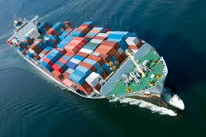
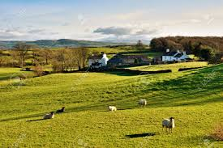
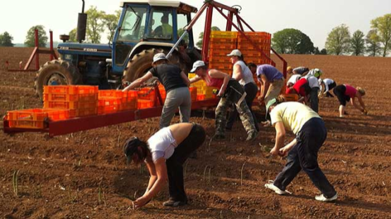
NFU’s Policy Priorities
Focus is on the four main policy areas of:
TRADE
DOMESTIC AGRICULTURAL POLICY
REGULATION
LABOUR

Slide 7
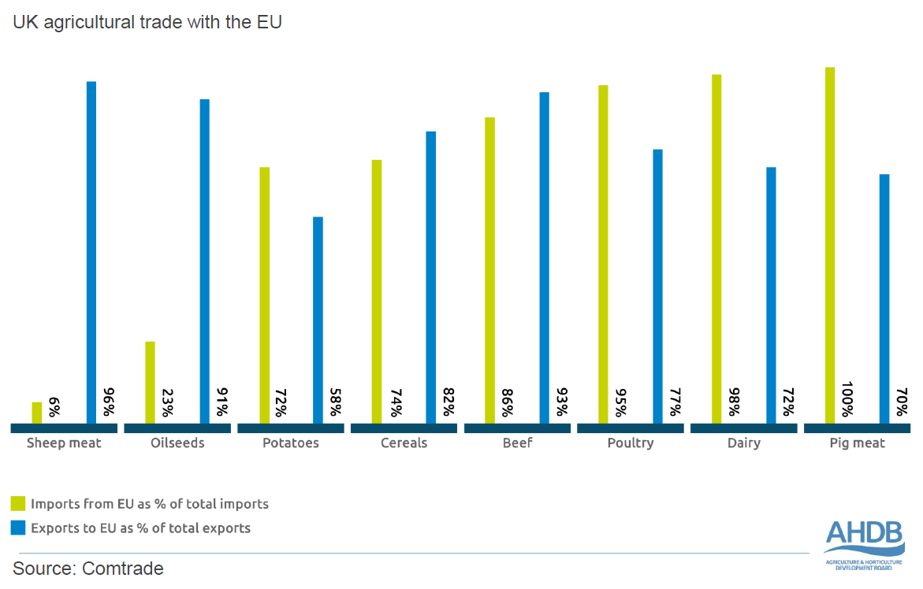
TRADE

Slide 8
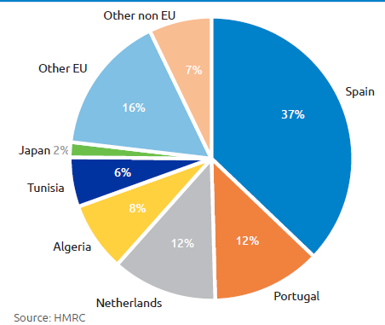
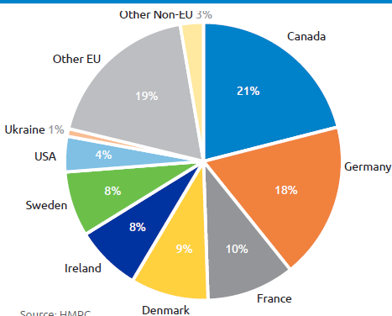
Trade – why does this matter to Cereal & Oilseeds sector?
UK wheat & barley IMPORTS 2015/16
UK wheat & barley EXPORTS 2015/16

Slide 9
Transition in Agricultural Policy
Productivity
Productivity
Innovation, skills & knowledge
Grants & Loans
NEGATIVE OUTCOMES ON TRADE, LABOUR & REGULATION
Volatility
Environment
Resource Efficiency
Direct Support
Environmental schemes
Other
Financial measures
TRANSITION
Productivity
Environment
Volatility
POSITIVE OUTCOMES ON TRADE, LABOUR & REGULATION
2019
Environment
Volatility
Notes:
Volatility mitigation through a direct payment open to all
Broad farmed environment scheme, voluntary, accessible to all
Farmed env scheme for designated areas (e.g. SSSI, National Parks) by application
Productivity measures (e.g. capital grants) by application
Animal and Plant health measures
Promotion of British Produce (e.g. facilitation and promotion of exports, assurance schemes) by application
Budget requirements not known until clarity over future trading arrangements (e.g. lamb exports and imports)
Too early to define the detail of policy instruments needed or relative weighting that they should be given. But need to develop thinking beyond the framework set out.

Slide 10
Seed issues
PVR – how will this work?
CPVO – can we be members?
Variety registration - Common catalogue and national listing
Investing in innovation

